Slide 1
Literary Terms 2

Slide 2
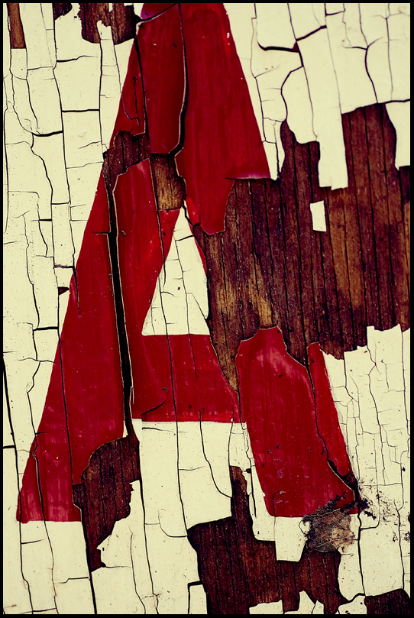
Alliteration
ALLITERATION is the repetition of a beginning consonant sound within a phrase or sentence.
Example:
‘we will sit down a little way within the wood, and rest ourselves.
The Scarlet Letter by Nathaniel Hawthorne

Slide 3
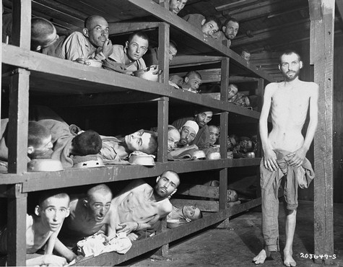
Allusion
ALLUSION is a direct or indirect reference to a significant person, event, time, or work of literature.
Example:
Some talked of God, of his mysterious ways, of the sins of the Jewish people, and of their future deliverance. But I had ceased to pray. How I sympathized with Job!
Night by Elie Wiesel

Slide 4
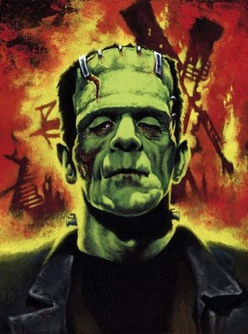
Analogy
An ANALOGY compares similar concepts, characters, or works of literature so the reader better understands a difficult idea.
Example:
Like Adam, I was apparently united by no link to any other being in existence; but his state was far different from mine in every other respect. Many times I considered Satan as the fitter emblem of my condition…
Frankenstein by Mary Shelley

Slide 5
Assonance
ASSONANCE is the repetition of identical or similar vowel sounds found within or at the end of words and phrases.
Example:
Is crimson in thy lips and in thy cheeks,…
Romeo and Juliet by William Shakespeare

Slide 6
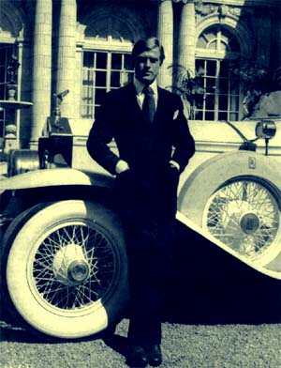
Cliché
A CLICHÉ is an expression that has been used so often that its meaning and impact are no longer effective.
Example:
“Oh, that’s all right,” he said carelessly.
“I don’t want to put you to any trouble.”
“What day would suit you?”
“What day would suit you?” he corrected me quickly.
“I don’t want to put you to any trouble, you see.”
The Great Gatsby by F. Scott Fitzgerald

Slide 7
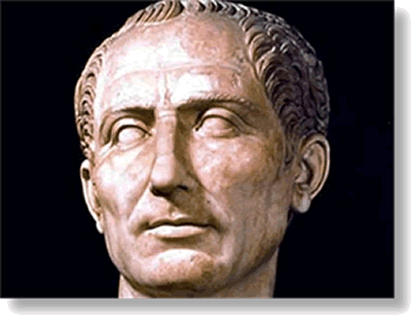
Consonance
CONSONANCE is the repetition of consonant sounds within or at the end of words in a phrase or sentence.
Example:
Now is it Rome indeed,
and room enough,
When there is in it
but one only man.
Julius Caesar by William Shakespeare

Slide 8
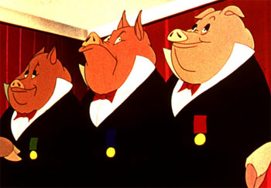
Euphemism
A EUPHEMISM is a polite word or phrase used in place of an offensive or crude word or phrase.
Example:
For the time being, certainly, it had been found necessary to make a readjustment or rations…
Animal Farm by George Orwell

Slide 9
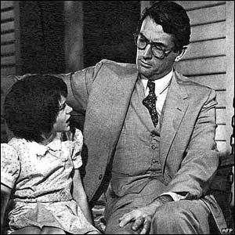
Hyperbole
A HYPERBOLE uses exaggeration to provoke strong emotion, to create humor, or to make a point.
Example:
“Your name’s longer’n you are. Bet it’s a foot longer.”
To Kill a Mockingbird by Harper Lee

Slide 10
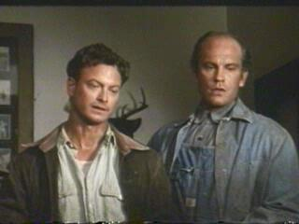
Idiom
An IDIOM is an expression that is clear only to those who are familiar with the language of its origin and cannot be understood based on its literal meaning.
Example:
“O.K. Someday – we’re gonna get the jack together and we’re gonna have a little house and a couple of acres an’ a cow and some pigs and –”
“An’ live off the fatta the lan’,” Lennie shouted.
Of Mice and Men by John Steinbeck

Slide 11
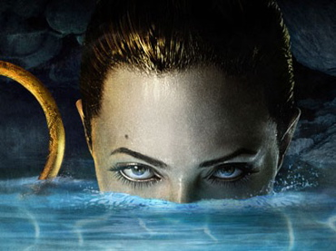
Imagery
IMAGERY is the use of figurative language to paint a sensory picture for the reader.
Example:
The greatest of funeral fires wound up to the clouds, it roared in front of the mound. Heads melted, wounds burst open, while blood gushed forth from the gashes in the bodies.
…Their mightiest men had departed.
Beowulf by Author Unknown

Slide 12
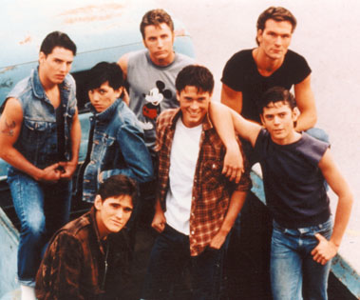
Irony
IRONY is what results when the actual outcome differs from what is expected.
Example:
Johnny had killed someone. Quiet, soft-spoken little Johnny, who wouldn’t hurt a living thing on purpose, had taken a human life.
The Outsiders by S.E. Hinton

Slide 13
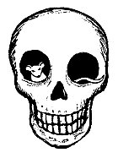
Metaphor
A METAPHOR compares similar things or ideas without using the words like or as.
Example:
I see now that when Norman flowered in our garden I became a weed, allowed to exist only where I would not be seen…
Flowers for Algernon by Daniel Keyes

Slide 14
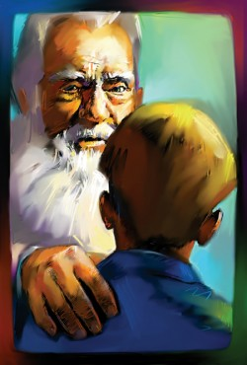
Onomatopoeia
ONOMATOPOEIA is a word or words that sound like the action or thing they describe or represent.
Example:
“Psssheeewwww!” A child’s voice, coming from
behind a nearby bush, made the sound.
“Pow! Pow! Pow!”
“You got me!” she called, and fell to the ground grinning.
“Blam!”
The Giver by Lois Lowry

Slide 15
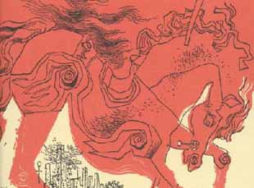
Oxymoron
An OXYMORON combines two words of contrasting meaning to convey a single idea or thought.
Example:
“…do you like school, and all that stuff”?
“It’s a terrific bore.”
The Catcher in the Rye by J.D. Salinger

Slide 16
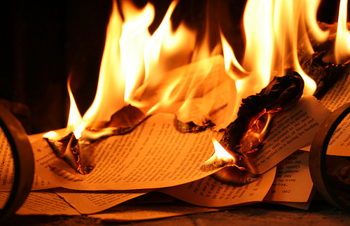
Paradox
A PARADOX is a statement that initially seems to contradict itself but, in fact, includes a fundamental truth.
Example:
They beat me with sticks. By the time I was forty my blunt instrument had been honed to a fine cutting point for me. If you hid your ignorance, no one will hit you and you’ll never learn.
Fahrenheit 451 by Ray Bradbury

Slide 17
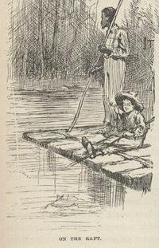
Personification
PERSONIFICATION is attributing human characteristics to inanimate objects, natural forces, animals, or ideas.
Example:
It was a steamboat that had killed herself on a rock. We was drifting straight down for her. The lightening showed her very distinct. She was learning over, …
Adventures of Huckleberry Finn by Mark Twain

Slide 18
Pun
A PUN uses similar or identical sounding words to create an alternate meaning to the sentence in which it is used.
Example:
Parris: Mister Hale! Oh, it’s good to see you
again! My, [these books] are heavy!
Hale: They must be; they are weighted with
authority.
Parris: Well, you do come prepared!
The Crucible by Arthur Miller

Slide 19
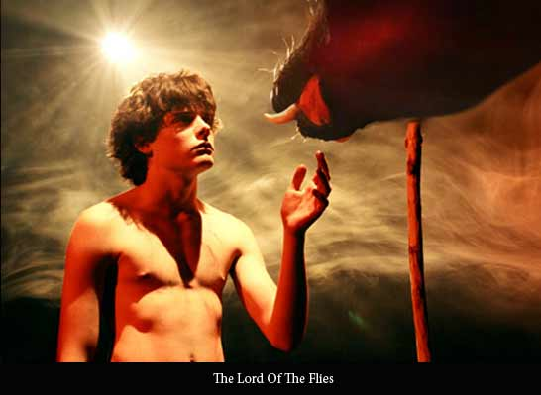
Simile
A SIMILE compares different things or ideas by using the words like or as.
Example:
Before them, something like a great ape was sitting asleep with its head between its knees. Then the wind roared in the forest, there was confusion, in the darkness and the creature lifted its head, …
Lord of the Flies by William Golding

