Slide 1
Literary Terms

Slide 2
Antagonist
The ANTAGONIST is the character who opposes the central character, causing conflict.
Example:
Kerchak grunted and turned away, for he was jealous of this strange member of his band. In his little evil brain he sought for some excuse to wreak his hatred upon Tarzan.
Tarzan of the Apes by Edgar Rice Burroughs

Slide 3
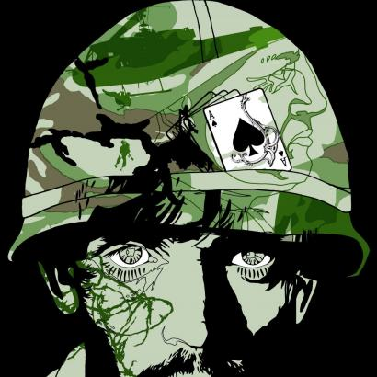
Characterization
CHARACTERIZATION uses direct and indirect methods to describe qualities and features of a person within a literary work.
Example:
As a big man, therefore a machine gunner, Henry Dobbins carried the M-60 which weighed 23 pounds unloaded, but which was almost always loaded.
The Things They Carried by Tim O’Brien

Slide 4
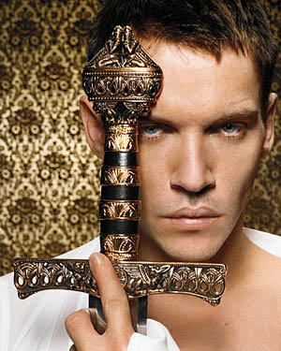
Climax
The CLIMAX marks the place in a literary work that is the most significant to the main character and/or plot.
Example:
It isn’t difficult to keep alive, friends – just don’t make trouble.”
A Man For All Seasons by Robert Bolt

Slide 5
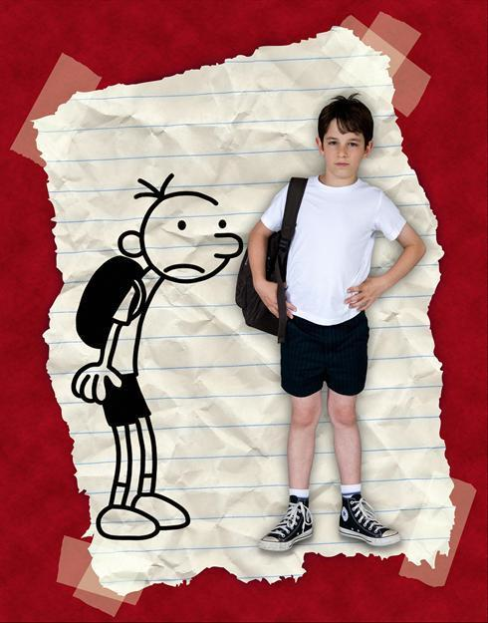
Conflict
CONFLICT is the struggle between two or more forces, internal and/or external that drive the plot.
Example:
I’ll be famous one day, but for now I’m stuck in middle school with a bunch of morons.
Diary of a Wimpy Kid by Jeff Kinney

Slide 6
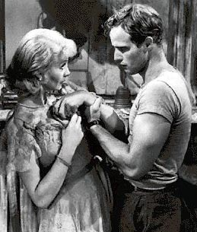
Connotation
CONNOTATION is the emotional, cultural, or suggested meaning thought of when hearing a word or phrase.
Example:
Your sister and I are having a talk.
A Streetcar Named Desire by Tennessee Williams

Slide 7
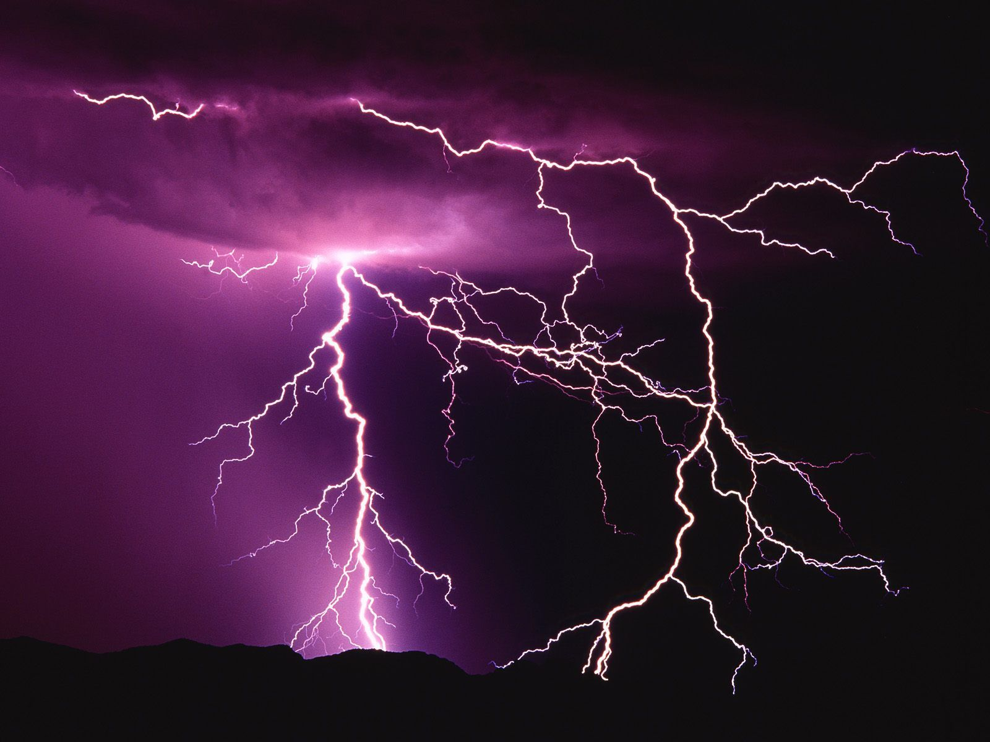
Dialogue
DIALOGUE is the representation of conversation within a literary work.
Example:
“Mama’ll be ‘fraid, yes,” he suggested with blinking eyes.
“She’ll shut the house. Maybe she got Sylvie helpin’ her this evening,” Bobinot responded reassuringly.
“No; she ent got Sylvie. Sylvie was helpin’ her yistiday,” piped Bibi.
The Storm by Kate Chopin

Slide 8
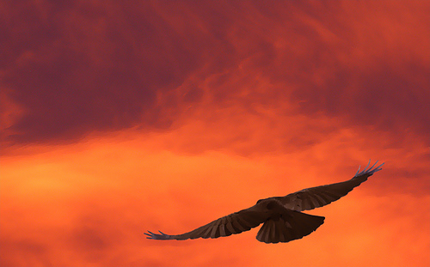
Figurative Language
FIGURATIVE LANGUAGE is the use of words to affect a meaning other than the usual or literal meaning of those words.
Example:
Well, I think we’re about two hundred miles from the coast. As the crow flies.
As the crow flies?
Yes. It means going in a straight line.
The Road by Cormac McCarthy

Slide 9
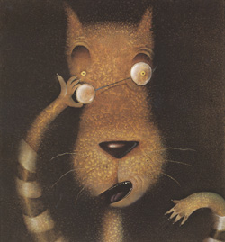
Flashback
A FLASHBACK is a scene that takes place earlier than the story’s current time.
Example:
Way back in Once Upon a Time time, I was making a birthday cake for my dear old granny.
The True Story of the Three Little Pigs
by John Scieszka & Lane Smith

Slide 10
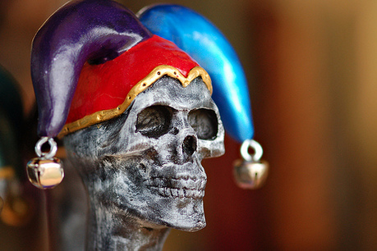
Foreshadowing
FORESHADOWING is an occurrence, feeling, or object that forewarns of an event and which is only fully understood in hindsight.
Example:
“You? Impossible! A mason?”
“A mason,” I replied.
“A sigh,” he said.
“It is this,” I answered, producing a trowel from beneath the folds of my roquelaire.
The Cask of Amontillado by Edgar Allan Poe

Slide 11
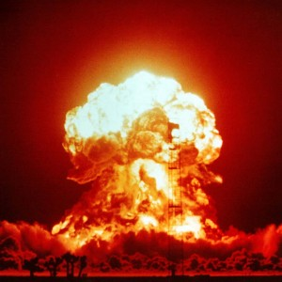
Genre
GENRE describes the various classifications of literary works (for example: comedy, science fiction, fantasy, mystery, short story, tragedy, etc…).
Example:
I promised to have this report on its way to the publishers today. In view of what has happened, I am obliged to break that promise, or release the report incomplete.
Report on the Barnhouse Effect by Kurt Vonnegut

Slide 12
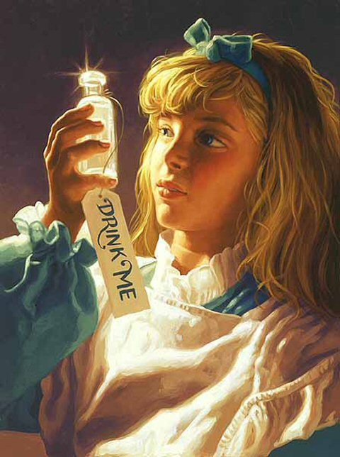
Plot
PLOT is the order in which the author has chosen to convey the events of a literary work.
Example:
However, the bottle was NOT marked “poison” so Alice ventured to taste it, and finding it very nice, (it had, in fact, a sort of mixed flavor of cherry-tart, custard, pineapple, roast turkey, toffee, and hot buttered toast,) [sic] she very soon finished it off.
Alice’s Adventures in Wonderland by Lewis Carroll

Slide 13
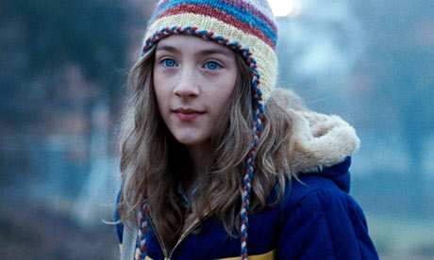
Point of View
POINT OF VIEW is the position or positions from which a literary work is told to the reader.
Example:
My name was Salmon, like the fish; first name, Suzie. I was fourteen when I was murdered on December 6, 1973.
The Lovely Bones by Alice Sebold

Slide 14
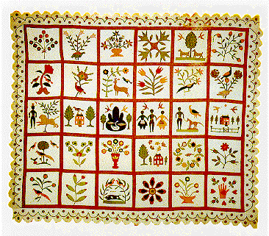
Protagonist
The PROTAGONIST is the principal or main character around which a literary work usually revolves.
Example:
Maggie by now was standing in the door. I could almost hear the sound her feet made as they scraped over each other.
Everyday Use by Alice Walker

Slide 15
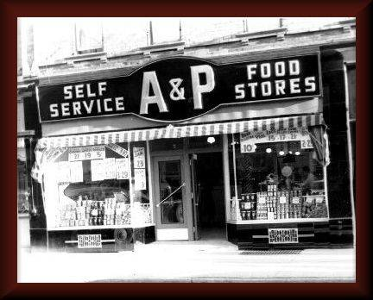
Resolution
RESOLUTION, or denouement. Is the event or events in a story that occur after the climax, but before the story’s actual end.
Example:
I look around for my girls, but they’re gone, of course.
A & P by John Updike

Slide 16
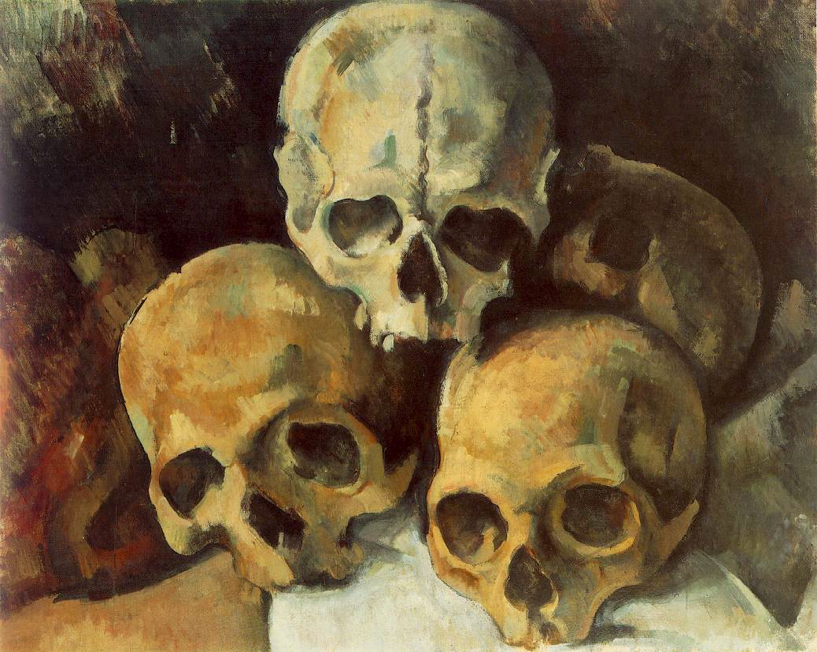
Setting
SETTING is the location and time period in which the plot takes place.
Example:
Its roof and floor were abundantly equipped with large stalactites and stalagmites, some of which met in columnar form; but important above all else was the vast deposit of shells and bones which in places nearly choked the passage.
At the Mountains of Madness by H.P. Lovecraft

Slide 17
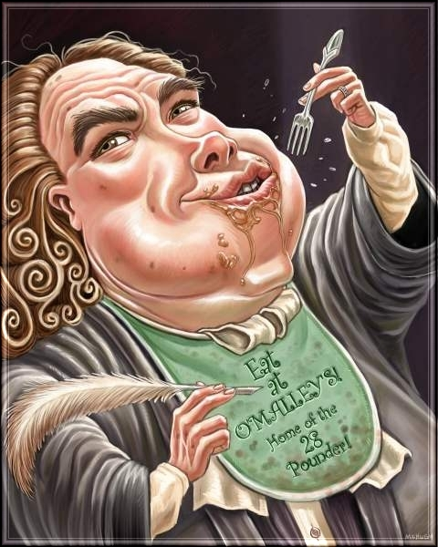
Style
STYLE is how the author’s specific use of words makes his or her writing distinctive.
Example:
I grant this food will be somewhat dear, and therefore very proper for landlords, who, as they have already devoured most of the parents, seem to have the best title to the children.
A Modest Proposal by Jonathan Swift

Slide 18
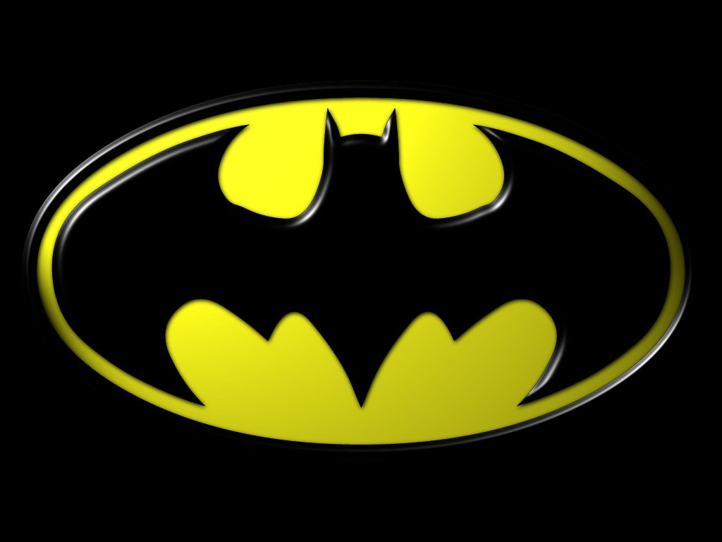
Symbol
A SYMBOL is a thing, person, or place that is presented as a representation of a larger meaning.
Example:
Yes, father. I shall become the bat.
Batman: Year One by Frank Miller

Slide 19
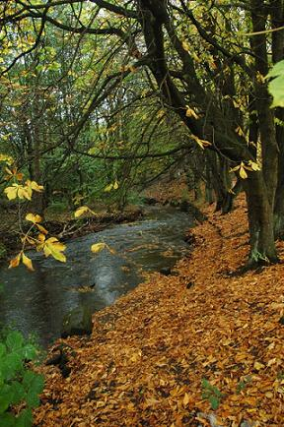
Theme
THEME is an abstract idea (such as ambition, duty, fear, freedom, jealousy, love, or truth) that dominates a literary work.
Example:
Solitude is not measured by the miles of space that intervene between a man and his fellows.
Walden, or Life in the Woods
by Henry David Thoreau

