Slide 1
PLOT

Slide 2
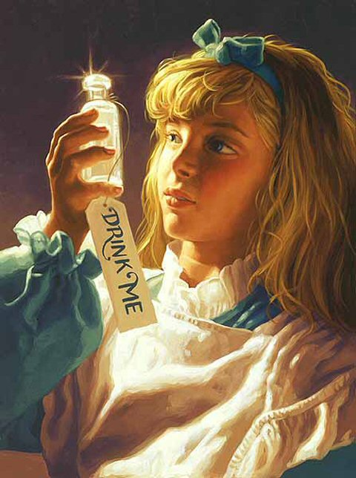
Plot
PLOT is the order in which the author has chosen to convey the events of a literary work.
Example:
However, the bottle was NOT marked “poison” so Alice ventured to taste it, and finding it very nice, (it had, in fact, a sort of mixed flavor of cherry-tart, custard, pineapple, roast turkey, toffee, and hot buttered toast,) [sic] she very soon finished it off.
Alice’s Adventures in Wonderland by Lewis Carroll

Slide 3
Plot Notes
The plot serves as a skeleton on which the other elements of a story (characters, setting, etc…) hang.
A plot usually involves the unfolding and solving of a conflict.
Plots can be simple or complex.
Most novels include a main plot and one or more subplots.

