Slide 1
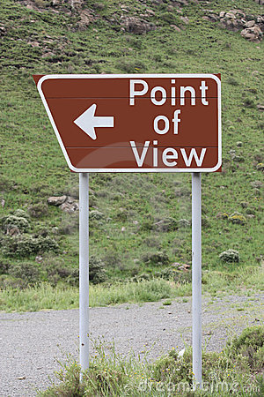

Slide 2
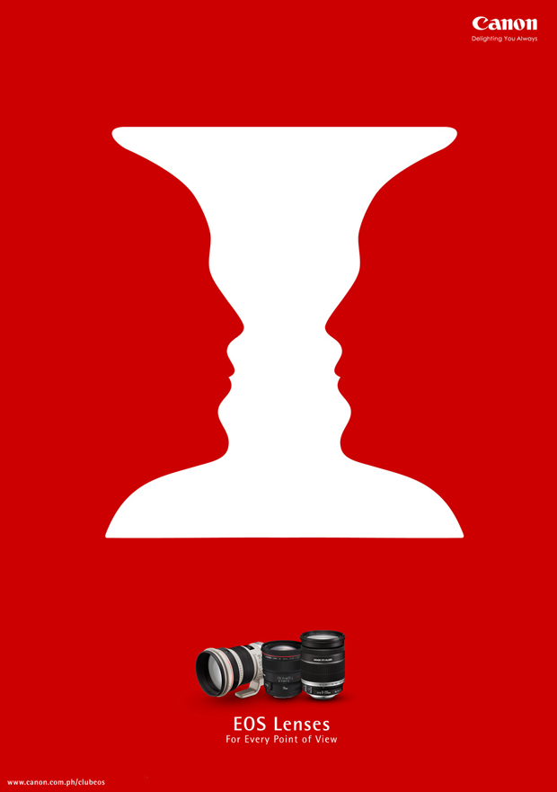

Slide 4
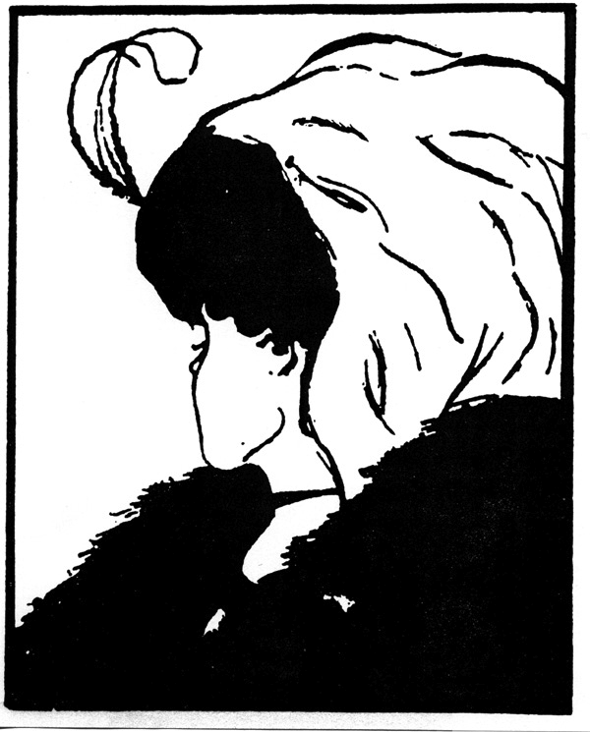

Slide 5
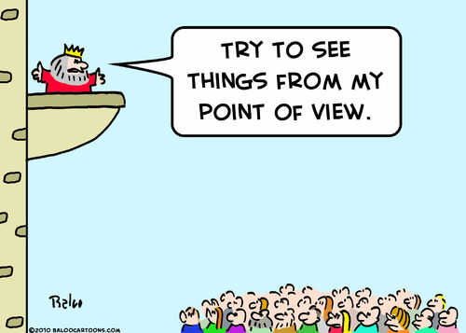

Slide 6
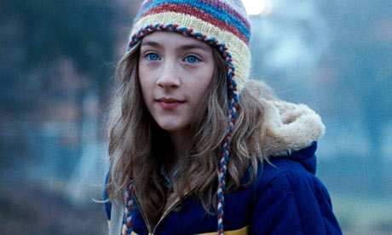
Point of View
POINT OF VIEW is the position or positions from which a literary work is told to the reader.
Example:
My name was Salmon, like the fish; first name, Suzie. I was fourteen when I was murdered on December 6, 1973.
The Lovely Bones by Alice Sebold

Slide 7
Point of View
The narrator’s position with respect to the characters and the reader.
Point of view helps determine when a reader is told, and when and how a reader feels about characters and events in a story.

Slide 8
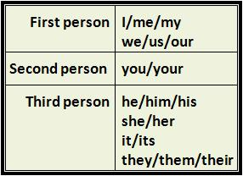
Point of View Chart

Slide 9
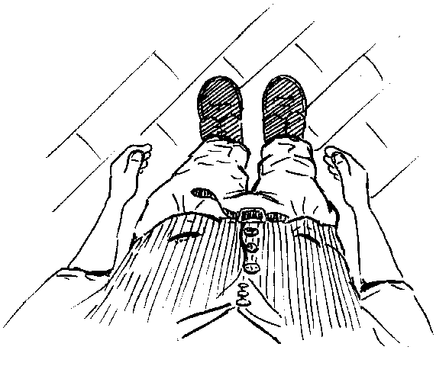

Slide 10
Different Types
First Person:
One of the story’s characters narrates using the pronoun I.

Slide 12
Different Types
Second Person:
The point of view places the reader in a story using the pronoun you.

Slide 13
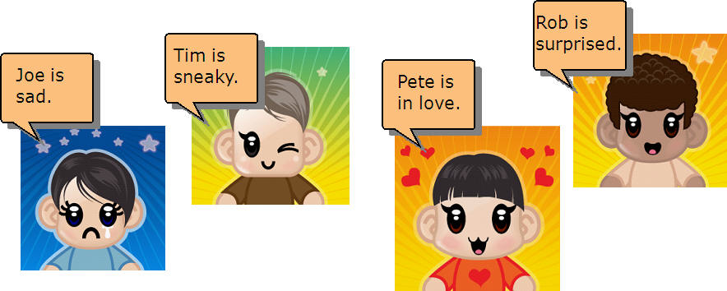

Slide 14
Different Types
Third Person (Limited):
The narrator is outside of the story and sees events through the eyes of only one character. Limited third person uses the pronouns she and he.

Slide 16
Different Types
All-knowing third person (Omniscient):
The narrator is not one of the characters in the story, but rather narrates as though looking in on the story and seeing the emotions, motives, and actions of all the characters. The narrator uses the pronouns he and she.

