Slide 1
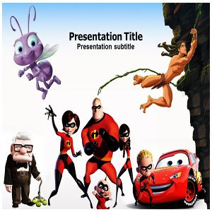
Protagonists & Antagonists

Slide 2
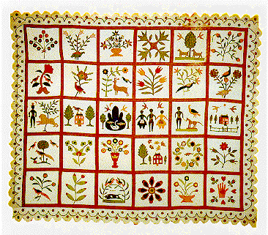
Protagonist
The PROTAGONIST is the principal or main character around which a literary work usually revolves.
Example:
Maggie by now was standing in the door. I could almost hear the sound her feet made as they scraped over each other.
Everyday Use by Alice Walker

Slide 3
Antagonist
The ANTAGONIST is the character who opposes the central character, causing conflict.
Example:
Kerchak grunted and turned away, for he was jealous of this strange member of his band. In his little evil brain he sought for some excuse to wreak his hatred upon Tarzan.
Tarzan of the Apes by Edgar Rice Burroughs

Slide 5
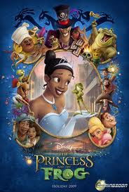
Name that Disney Movie
Protagonist | Movie | Antagonist
Tiana |  | Doctor Facilier

Slide 6
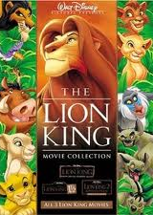
Name that Disney Movie
Protagonist | Movie | Antagonist
Simba |  | Scar

Slide 7
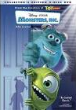
Name that Disney Movie
Protagonist | Movie | Antagonist
James P. Sullivan Michael Wazowski |  | Randall Boggs Henry Waternoose III

Slide 8
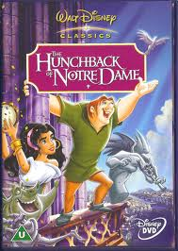
Name that Disney Movie
Protagonist | Movie | Antagonist
Quasimodo |  | Judge Claude Frollo

Slide 9
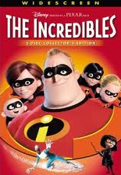
Name that Disney Movie
Protagonist | Movie | Antagonist
Bob Parr (Mr. Title Character) |  | Buddy Pine

Slide 10
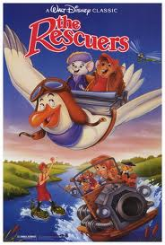
Name that Disney Movie
Protagonist | Movie | Antagonist
Penny |  | Madame Medusa

Slide 11
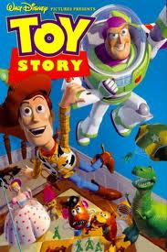
Name that Disney Movie
Protagonist | Movie | Antagonist
Woody Buzz Lightyear |  | Lotso

Slide 12
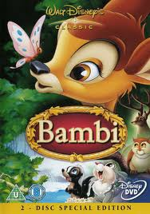
Name that Disney Movie
Protagonist | Movie | Antagonist
Title Character (an animal) |  | Man

Slide 13
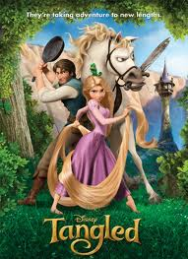
Name that Disney Movie
Protagonist | Movie | Antagonist
Rapunzel |  | Mother Gothel

Slide 14
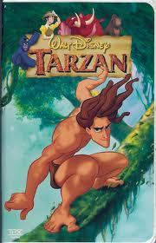
Name that Disney Movie
Protagonist | Movie | Antagonist
Title Character |  | Clayton

Slide 15
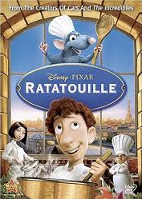
Name that Disney Movie
Protagonist | Movie | Antagonist
Remy Alfredo Linguini |  | Skinner

Slide 16
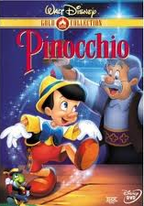
Name that Disney Movie
Protagonist | Movie | Antagonist
Title Character |  | Monstro the Whale & Stromboli

Slide 17
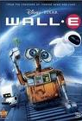
Name that Disney Movie
Protagonist | Movie | Antagonist
Title Character Eve |  | Auto

Slide 18
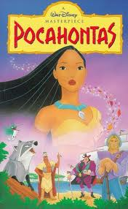
Name that Disney Movie
Protagonist | Movie | Antagonist
Title Character |  | Governor Ratcliffe

Slide 19
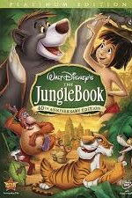
Name that Disney Movie
Protagonist | Movie | Antagonist
Mowgli |  | Shere Khan

Slide 20
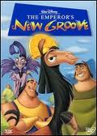
Name that Disney Movie
Protagonist | Movie | Antagonist
Emperor Kuzco |  | Yzma

Slide 21
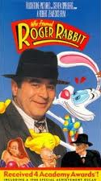
Name that Disney Movie
Protagonist | Movie | Antagonist
Eddie Valiant Title Character |  | Judge Doom

Slide 22
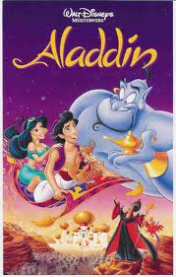
Name that Disney Movie
Protagonist | Movie | Antagonist
Title Character |  | Jafar

Slide 23
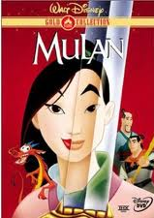
Name that Disney Movie
Protagonist | Movie | Antagonist
Title Character |  | Shan Yu

Slide 24
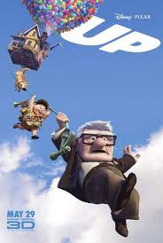
Name that Disney Movie
Protagonist | Movie | Antagonist
Carl Fredricksen |  | Charles F. Muntz

Slide 25
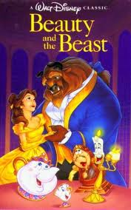
Name that Disney Movie
Protagonist | Movie | Antagonist
Belle Beast |  | Gaston

Slide 26
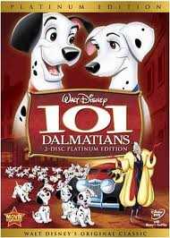
Name that Disney Movie
Protagonist | Movie | Antagonist
Pongo Perdita |  | Cruella De Vil

Slide 27
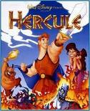
Name that Disney Movie
Protagonist | Movie | Antagonist
Hercules |  | Hades

