Slide 2
Theme
THEME is an abstract idea (such as ambition, duty, fear, freedom, jealousy, love, or truth) that dominates a literary work.
Example:
Solitude is not measured by the miles of space that intervene between a man and his fellows.
Walden, or Life in the Woods
by Henry David Thoreau

Slide 3
Theme
Theme:
Indirectly expressed insight.
Most literary works have at least one theme.
Many express several themes that are tied together.

Slide 4
Notes:
http://www.shmoop.com/hunger-games/themes.html

Slide 5
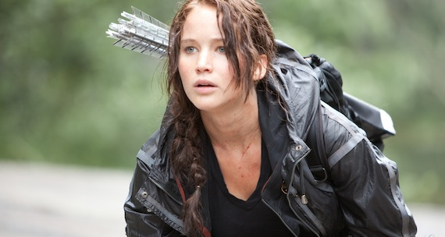
The Hunger Games Themes
Power
Versions of Reality
Identity
Society and Class
Love
Strength and Skill
Appearances
Politics
Competition
Sacrifice
Notes:
Power – Who has the power. The main source of power in the Hunger Games is clear: the totalitarian government of the Capitol.
Versions of Reality – The people of Panem watch lots of reality TV.
Identity – Before the Hunger Games, Katniss Everdeen was a hunter and gatherer in District 12 in the country of Panem.
Society and Class – The Hunger games is a novel about the “haves” and “have nots”
Love -

Slide 6
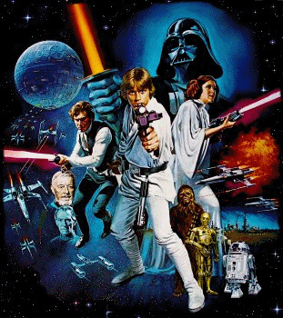
Notes:
http://www.shmoop.com/hunger-games/themes.html

Slide 7
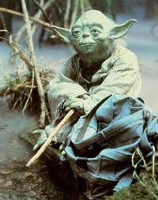
Star Wars Themes
The Mystery and Power of the Force
Good versus Evil
The Hero’s Destiny
Teamwork
Notes:
Power – Who has the power. The main source of power in the Hunger Games is clear: the totalitarian government of the Capitol.
Versions of Reality – The people of Panem watch lots of reality TV.
Identity – Before the Hunger Games, Katniss Everdeen was a hunter and gatherer in District 12 in the country of Panem.
Society and Class – The Hunger games is a novel about the “haves” and “have nots”
Love -

Slide 8
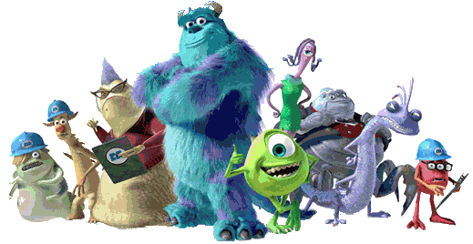
Notes:
http://www.shmoop.com/hunger-games/themes.html

Slide 9
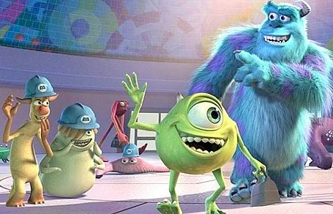
Monsters, Inc. Themes
Stereotypes
Teamwork
Good versus Evil
Friendship
Notes:
Power – Who has the power. The main source of power in the Hunger Games is clear: the totalitarian government of the Capitol.
Versions of Reality – The people of Panem watch lots of reality TV.
Identity – Before the Hunger Games, Katniss Everdeen was a hunter and gatherer in District 12 in the country of Panem.
Society and Class – The Hunger games is a novel about the “haves” and “have nots”
Love -

Slide 10
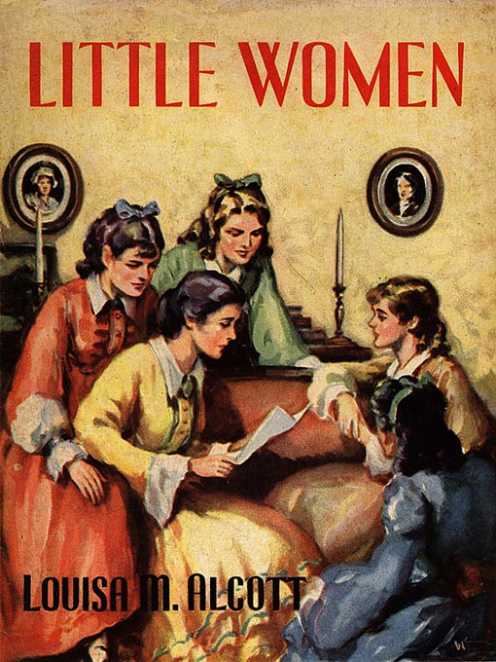
Example from Literature
Themes in Louisa May Alcott’s Little Women include the independence of the human spirit and the positive ties of family.

Slide 11
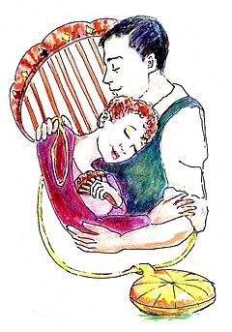
Example from Literature
O. Henry’s “The Gift of the Magi” expresses a theme of selfless love that is state almost as a simple moral at the end of the story.
After hearing about a man and woman who give away their own prized possessions to purchase treasures for each other, the reader is clued in to the story’s theme/moral:

Slide 12
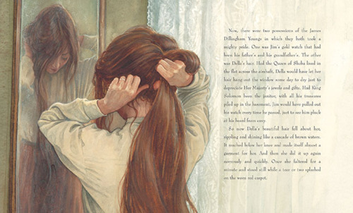
“The Gift of the Magi”
“But in a last word to the wise of these days, let it be said that of all who give gifts these two were the wisest. Of all who give and receive gifts, such as they are wisest. Everywhere they are wisest. They are the Magi.”

Slide 13
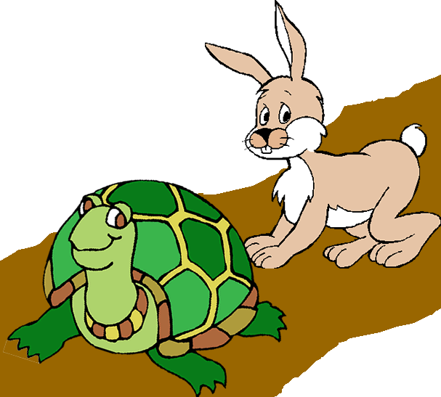
Moral
Moral:
The lesson expressed in a simple story.
Fables and parables are specifically designed to teach a moral, which often appears in a single statement at the end.
In more complex stories, lessons, and other messages about human nature are buried in the text.

Slide 14
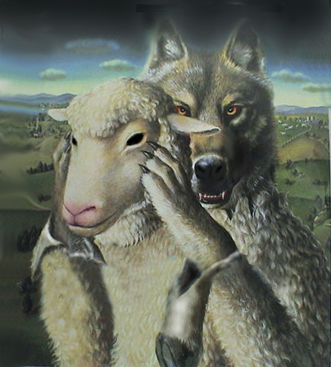
Examples from Literature
Aesop’s fables state clear-cut morals such as this one from “The Wolf in Sheep’s Clothing”:
“Appearances are often deceiving.”

